Slide 1
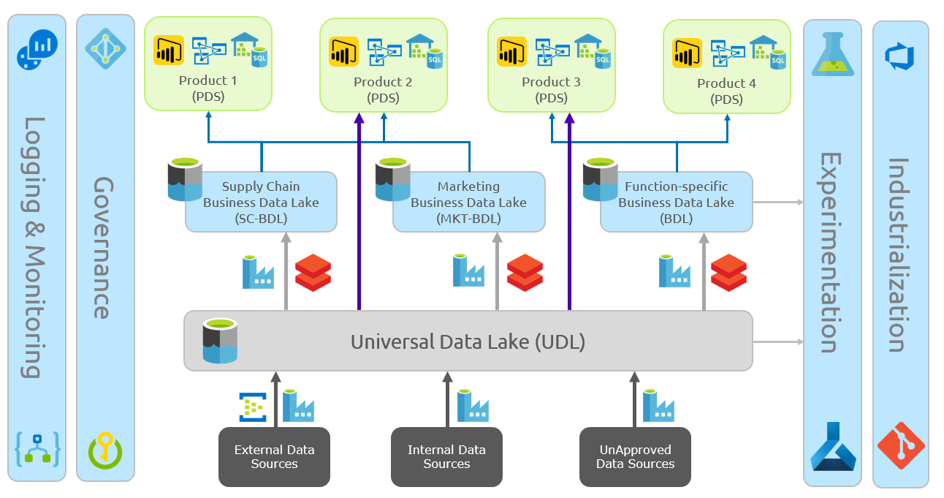
Enterprise wide Business Data Lake Engineering Program
-Leading Consumer Goods Provider in Europe
Client Overview
  Business objective is to build a Data Lake on Azure which is a single shared capability which will act as a source for all analytics works in the organization with the data scattered across 20+ business units and its sources maintaining the data in its native form. The scope includes Application modernization/migration to Azure from its existing on-premise analytical engine to Azure there by building Enterprise data strategy & Build Data platform and establish Operational excellence through Data Ops process
Architecture
Volumetric for one of its business Unit
UDL consists of ~10TB of data form 40+ European countries
40+ countries, 5000 business objects, 3000 reports and self-service models
1000+ user stories
11 years if historical data from legacy systems like Teradata & SAP is moved to Azure
Benefits Received
30% performance improvement
25% on manual effort reduction
50% Infrastructure cost reduction
Scale up/ Down Azure environment
Self Service reporting for business users
Re-usable components
Tech Stack: ADLS Gen2, Azure Databricks, Synapse Analytics, Azure SQL DB, AAS, Azure ML, Azure DevOps, PowerBI
Notes:
Zurich Insurance

Slide 2
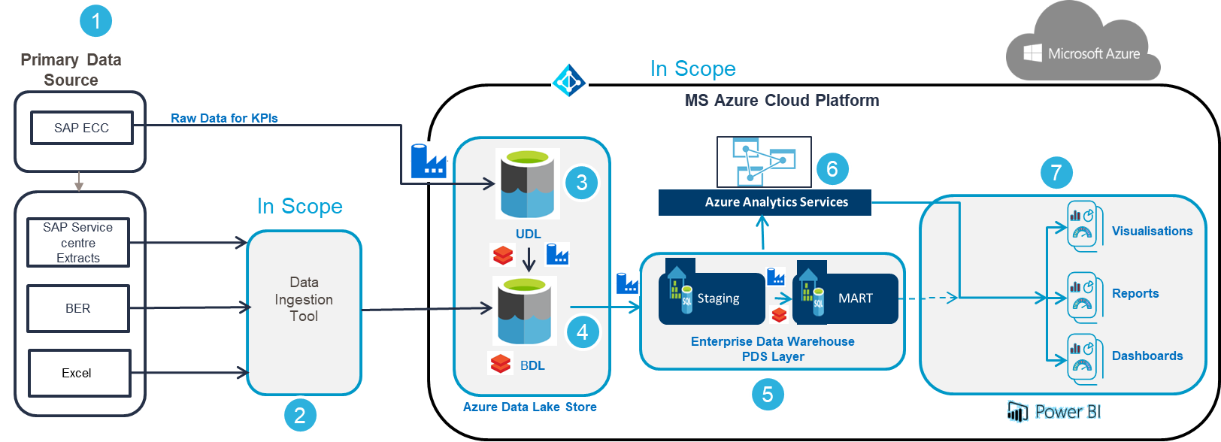
Case Study – Migrating Teradata to Azure (HRA)
Client is a Global retail Company
Situation
Solution Approach
Client Benefits
  Client is embarking to strengthen and expand its analytics platform by porting current on-premise Enterprise Analytics platform (data and processes) to the Azure cloud.
  Client high level scope of work includes:
  Migrate all on-premises Historical data (~11 years) from Tearadata, SQL Server and Cloud SaaS application to Azure
  Ingest all data sources in to cloud platform
  Build current data warehouse logic and create the resultant output tables for consumption in Azure cloud
  Re-develop current Tableau reports in Power BI
  Test all modules in scope (functional and non-functional)
  Adopt CI/CD modules
  Ensure high availability and disaster recovery
    The technology choices were vetted by Capgemini by assessing decision basis and technology vetting to help identify any risks, challenges to help determine the best fit for Client’s migration
    Capgemini presented most cloud native and strategic option that best fitted Client’s requirements and budget.
    Our solution easily integrates with existing DevOps framework of client.
    Capgemini recommended Azure Data Bricks/Spark based solution with Audit Balance Control and Scheduling approach
    High level flow is:
  SAP Raw source →Universal Data Lake Store (On ADLS)→ Business Data Lake Store (on ADLS) → Product data Store (On Azure SQL DW)→ Power BI
  Migration of Enterprise Analytics platform, which will help enable:
Elastic compute and storage for cost control
Flexibility for newer analytics
Better scalability for data growth and processing
  Use of Agile methodology along with existing DevOps framework for client
  Leveraging our technology, domain expertise from CoE for successful engagement
  End-to-End layered and configurable testing framework which manages data reconciliation and automated data validation
Reusable components and scripts are developed for future environment for Statistical model building.
30% performance improvement through scalable Azure based Architecture.
25% on manual effort reduction through automation.
50% Infrastructure cost reduction through Cloud based Azure Architecture.
Notes:
Zurich Insurance

Slide 3
Case Study – NA OTC in ADLS
Client – CP company headquartered in the UK
Situation
Solution Approach
Client Benefits
  Client is embarking to strengthen and expand its analytics platform by porting current on-premise Enterprise Analytics platform (data and processes) to the Azure cloud.
  Client high level scope of work includes:
  Migrate all on-premises Historical data (~5 years) from Teradata to Azure Cloud
  Ingest all data sources in to cloud platform
  Build current data warehouse logic and create the resultant output tables in Azure cloud Platform.
  Test all modules in scope (functional and non-functional)
  Adopt CI/CD modules
  Ensure high availability and disaster recovery
  Re-develop current Tableau reports in Power BI
  Migrate OTC Connect self service cube to Azure Cube
    The technology choices were vetted by Capgemini by assessing decision basis and technology vetting to help identify any risks, challenges to help determine the best fit for Client’s migration
    Capgemini presented most cloud native and strategic option that best fitted Client’s requirements and budget.
    Our solution easily integrates with existing DevOps framework of client.
    Capgemini recommended Azure Databricks/Spark based solution for Data Transformation with Audit Balance Control and Azure Datafactory for Scheduling the Jobs and for Storage Azure DataLake Store is used.
    High level flow is:
  SAP Raw source →Universal Data Lake Store (UDL On ADLS)→ Business Data Lake Store (BDL on ADLS) → Product data Store (PDS On Azure SQL DW)
  Migration of Enterprise Analytics platform, which will help enable:
Elastic compute and storage for cost control
Flexibility for newer analytics
Better scalability for data growth and processing
  Use of Agile methodology along with existing DevOps framework for client
  Leveraging our technology, domain expertise from CoE for successful engagement
  End-to-End layered and configurable testing framework which manages data reconciliation and automated data validation
Reusable components and scripts are developed for future environment for Statistical model building.
30% performance improvement through scalable Azure based Architecture.
25% on manual effort reduction through automation.
50% Infrastructure cost reduction through Cloud based Azure Architecture.
Notes:
Zurich Insurance

Slide 4
Case Study – Supply Chain Procurement in Azure Data Lake
Situation
Solution Approach
Client Benefits
  Client is embarking to strengthen and expand its analytics platform by using data from the Teradata, SAP HANA & Oracle MDM system to the Azure cloud system for processing and to have supply chain analytics/analysis in place for effective management decisions.
  And as the growth of data both internal and external grows exponentially, the traditional methods of storing vast volumes of data in a database or data warehouse are no longer sustainable or cost effective
  Client high level scope of work includes:
  Ingest Historical data (~5 years) from Teradata / SAP /oracle MDM to Azure cloud (UDL)
  Transform the source data into BDL (Biz data lake) using the Azure Data Bricks
  Test all modules in scope (functional and non-functional)
  Adopt CI/CD modules
  Ensure high availability and disaster recovery
  Re-develop current Tableau reports in Power BI
    The technology choices were vetted by Capgemini by assessing decision basis and technology vetting to help identify any risks, challenges to help determine the best fit for the Client’s end solution
    Capgemini presented most cloud native and strategic option that best fitted Client’s requirements and budget.
    Our solution easily integrates with existing DevOps framework of client.
    Sprint Phased approach with minimal disruption, Testing & Validation centricity and Agility in Execution
    Capgemini recommended Azure Data Bricks/Spark based solution with Audit Balance Control and Scheduling approach
    High level flow is:
  SAP Raw source →Universal Data Lake Store (On ADLS)→ Business Data Lake Store (on ADLS) → Product data Store (On Azure SQL DW) → Azure Analysis services →Power BI Visualization
  Enterprise Analytics platform, which will help enable:
Elastic compute and storage for cost control
Flexibility for newer analytics
Better scalability for data growth and processing
Self service BI (cube connected to MS excel)
  Use of Agile methodology along with DevOps framework for client
  Leveraging our technology, domain expertise from CoE for successful engagement
  End-to-End layered and configurable testing framework which manages data reconciliation and automated data validation
Reusable components and scripts are developed for future environment for Statistical model building.
30% performance improvement through scalable Azure based Architecture.
35% on manual effort reduction through automation.
50% Infrastructure cost reduction through Cloud based Azure Architecture.
Notes:
Zurich Insurance

